Slide 1

Reinforcement Learning
By,
Manasvi

Slide 2
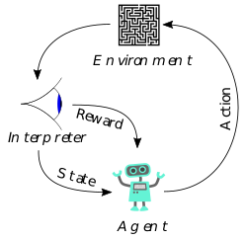
Reinforcement learning is a machine learning training method based on rewarding desired behaviors and/or punishing undesired ones. In general, a reinforcement learning agent is able to perceive and interpret its environment, take actions and learn through trial and error.

Slide 3
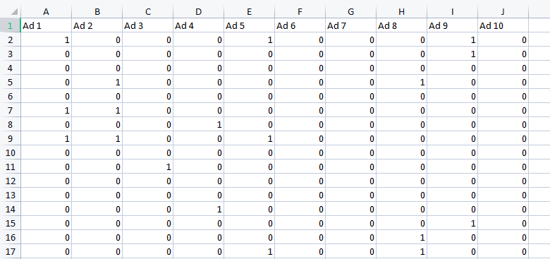
The Dataset chosen: Ads CTR optimization
The dataset gives us the data about the Clickthrough rate of different ads of a certain company. All these ads are designed based on the same product
Goal : To find which ad attracts multiple audience and optimization of CTR(clickthrough rate )

Slide 4
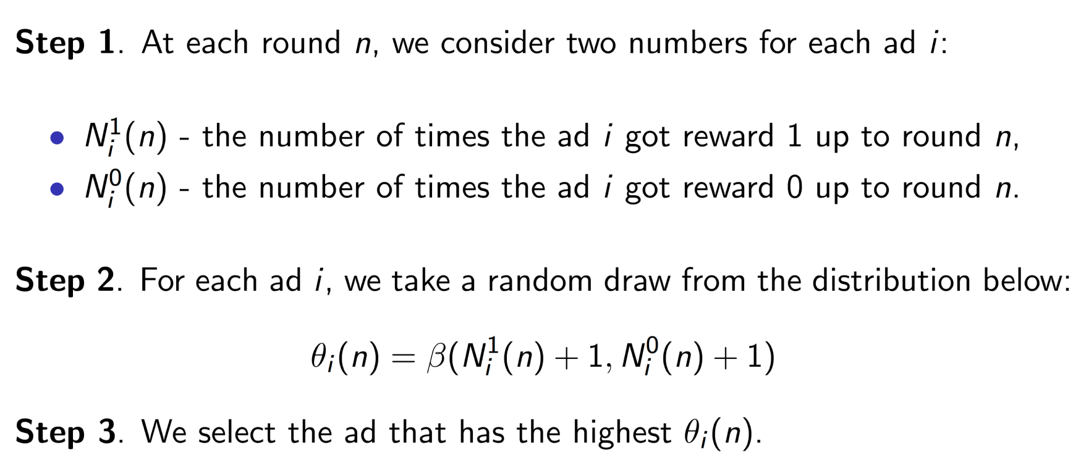
Approach :Thompson Sampling
Steps to apply Thompson Sampling:

Slide 5
Work Flow
Importing required libraries
Importing Dataset
Implementing Thompson Sampling
Visualize the results for analysis

Slide 6
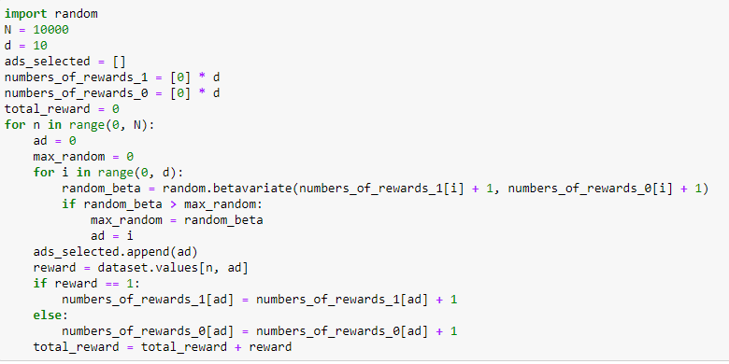
Implementation of Thomson sampling:

Slide 7
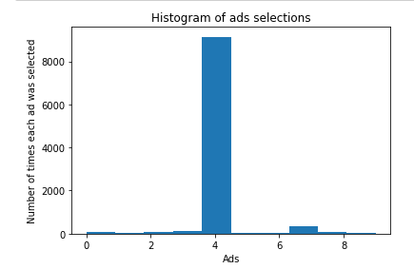
Results:
From the results we can conclude that Ad 4 has highest number of clicks i.e it is most liked by the viewers during the trial run.
By thompson sampling we found out which ad has better CTR for max profit

Slide 8
Thank You

